Slide 1



Infosys Springboard Internship 6.0 TeamB
Fleet Management and Route optimization System
Team Members :
1.Sanchita Mondal
2.Yamuna
3 .Keerthi Padamata
4.Ragasri
5.Chinmayi

Slide 2



1. Problem Statement
Efficient fleet management is a critical challenge for organizations that operate multiple vehicles and drivers. Traditional systems often lack:
1
Centralized visibility of vehicle and driver data.
2
Real-time route analysis.
3
Clear insights into vehicle health and performance.

Slide 3
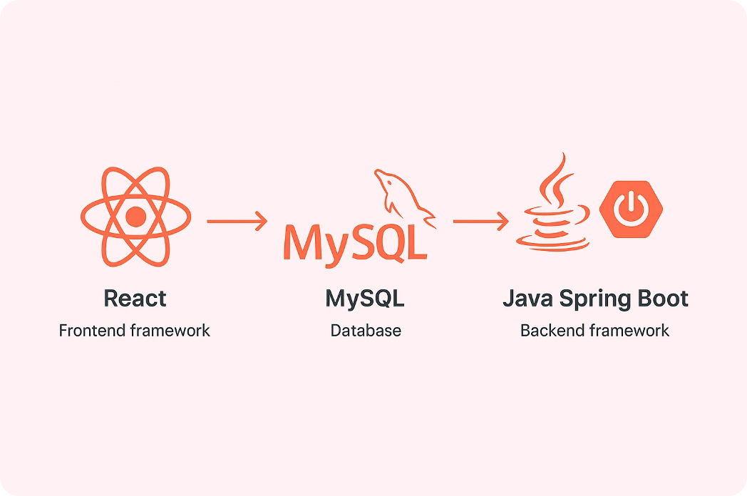
2.Tech stack

Slide 4
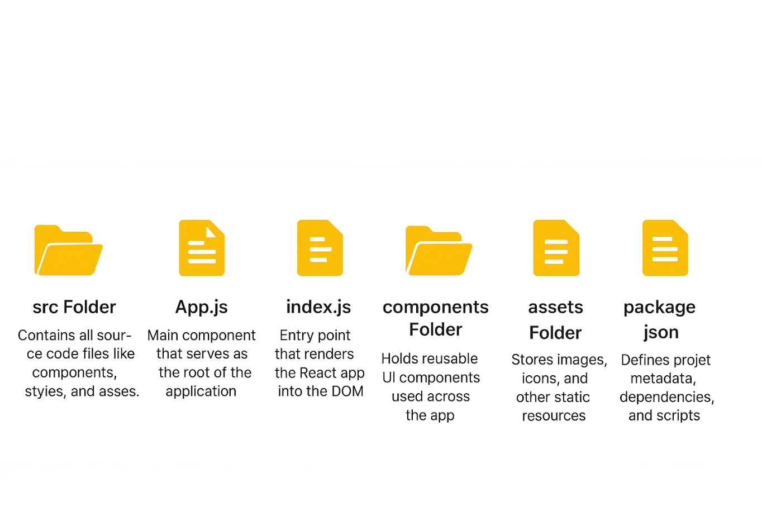
3.File System of react

Slide 5
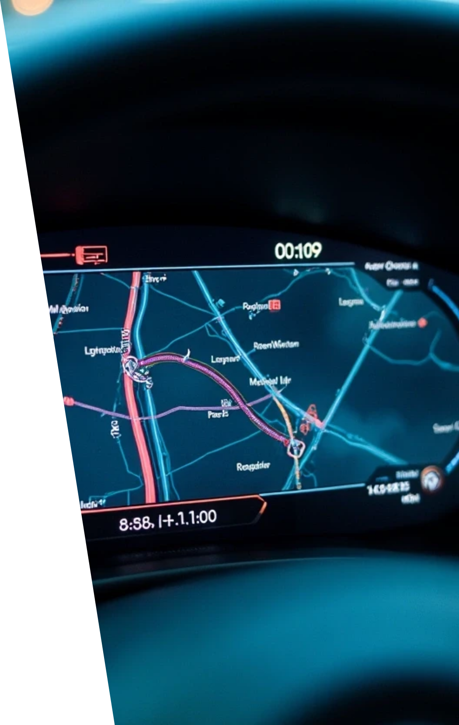
4.Proposed Solution – Fleet Management & Route Optimization System
The proposed system provides a centralized digital platform to
manage vehicles, drivers, and bookings efficiently while offering
analytical insights and static route optimization.
Centralized Dashboard: Unified view of fleet status, driver availability, and bookings.
Vehicle & Driver Management: Add, update, and monitor records in real time.
Manual Booking System: Gmail-linked user for trip scheduling and tracking.
Vehicle Health Monitoring: Tracks engine, brakes, fuel, and performance parameters.
Static Route Optimization: Calculates direct (non-traffic) distance between points.
Data Visualization: Charts and reports for performance analysis.

Slide 6


5. Key Features
Vehicle Management
Driver Management
Booking System
Add and view vehicle details.
Static driver data currently managed by Gmail-linked account.
Book drivers manually using your email for each trip.
Vehicle Health Check
Route Distance
Dashboard Analytics
Tracks parameters like engine, brakes, accelerator, and fuel.
Shows direct distance between points (non-traffic aware).
Displays pie and bar charts for health and driver status.

Slide 7
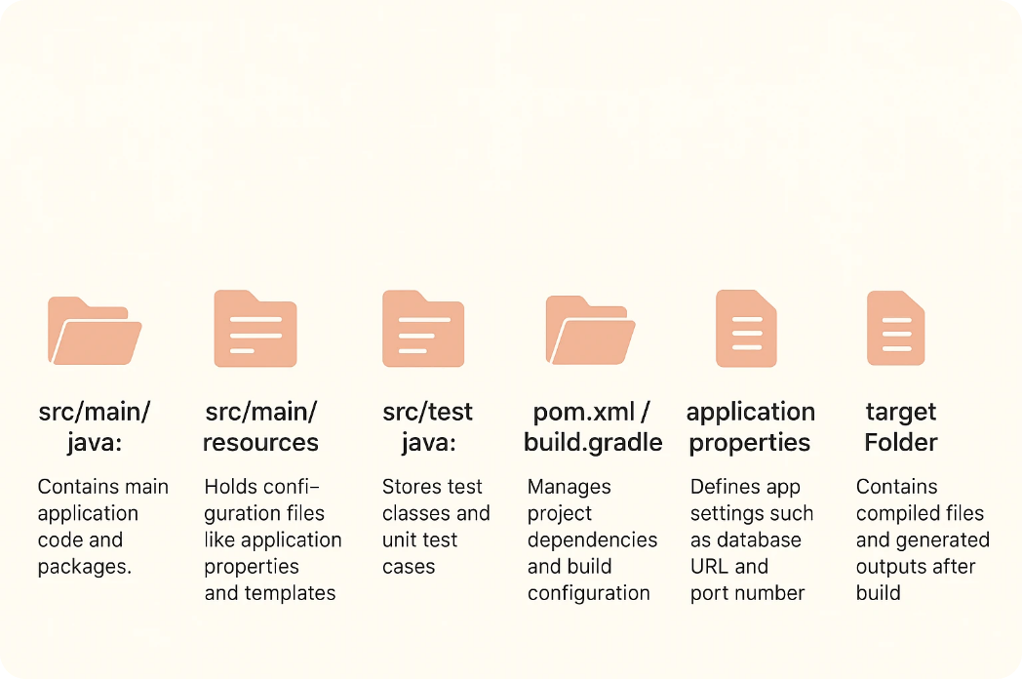
6.File system Java Spring boot

Slide 8
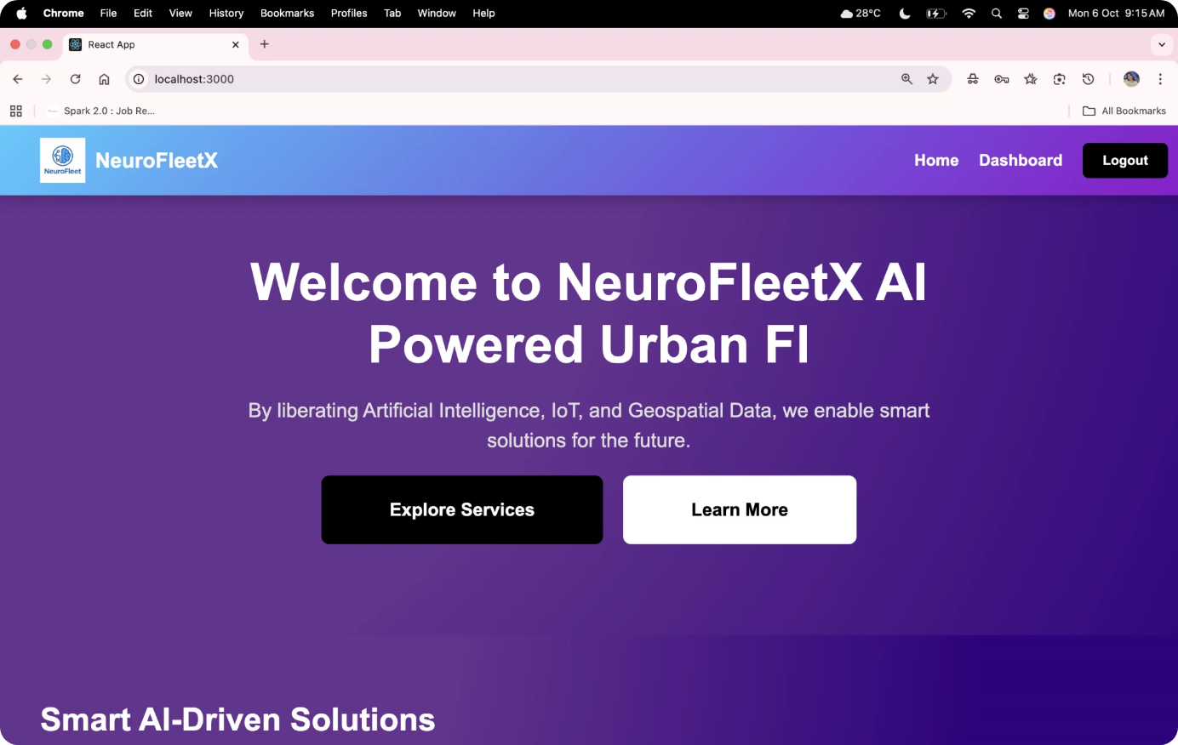
7.Module 1 – Login / Dashboard Page
Shows the fleet overview with status cards and charts

Slide 9
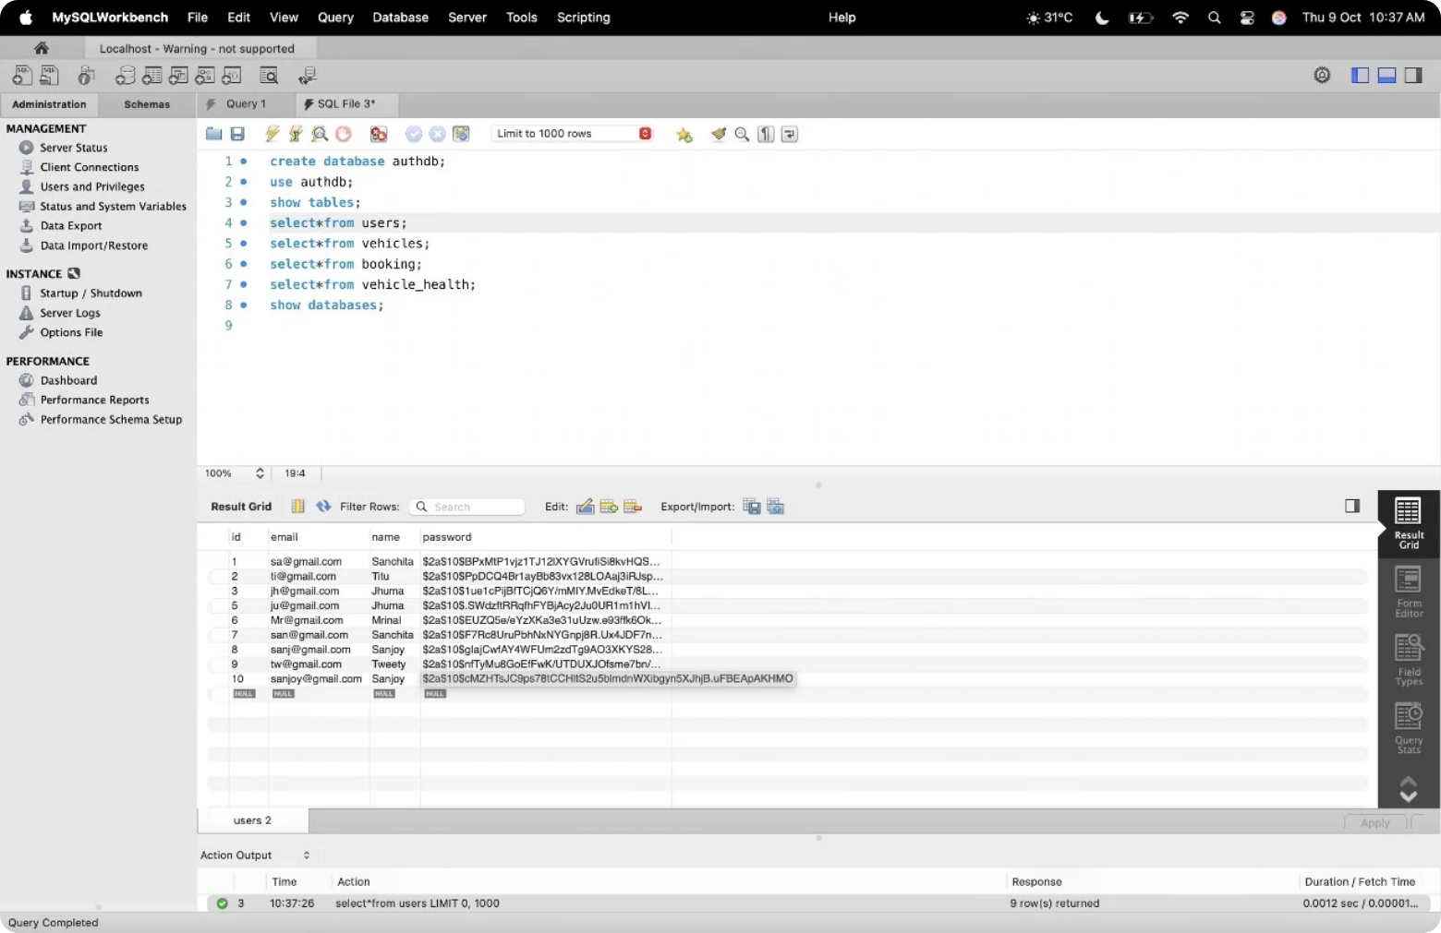
8. Login Database
Stores the detials of the Mailid,Username ,Password.

Slide 10
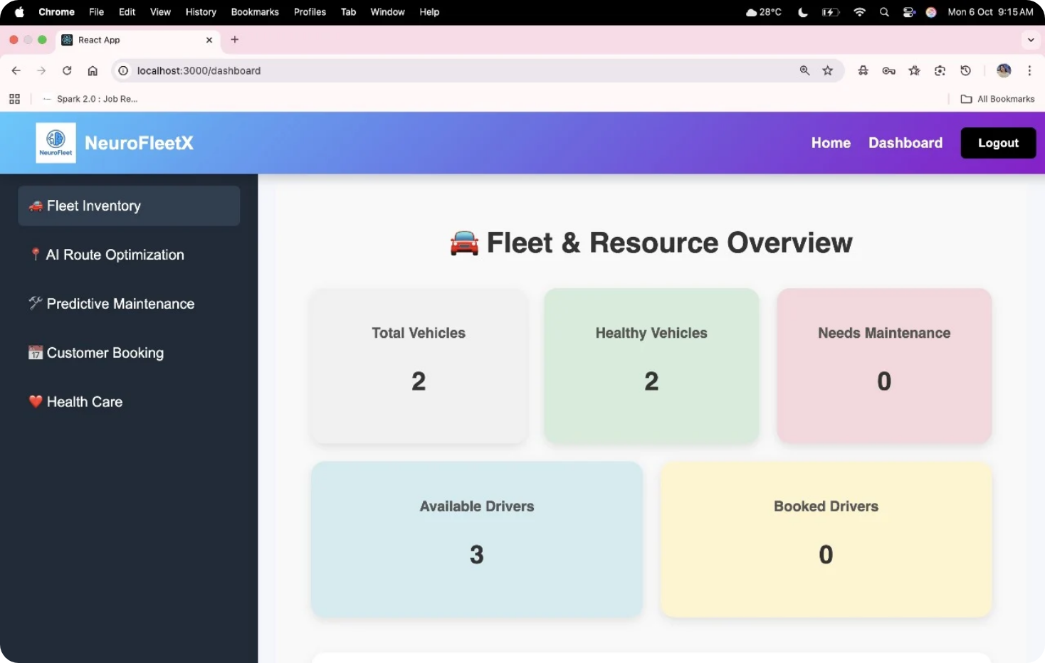
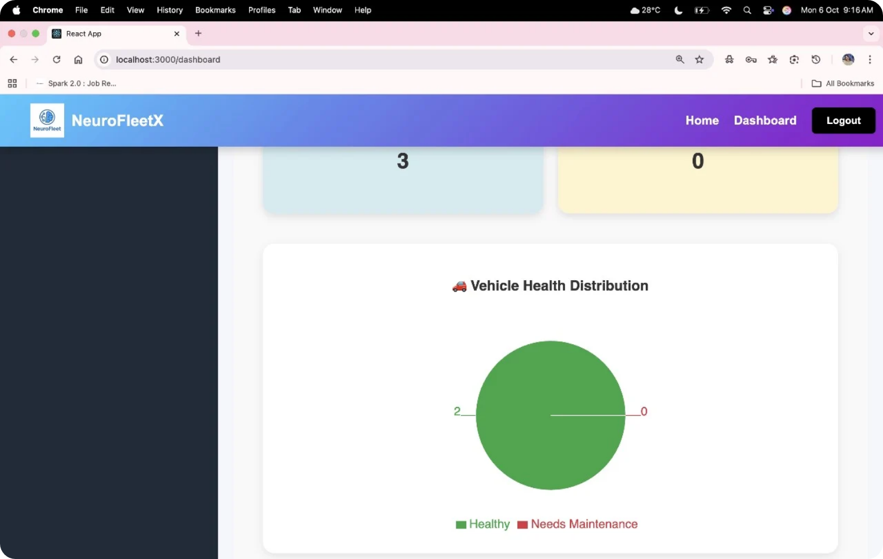
9. Module 2 - Fleet Inventory
Displays all vehicles, add/remove functionality and also Vehicle health distribution.

Slide 11
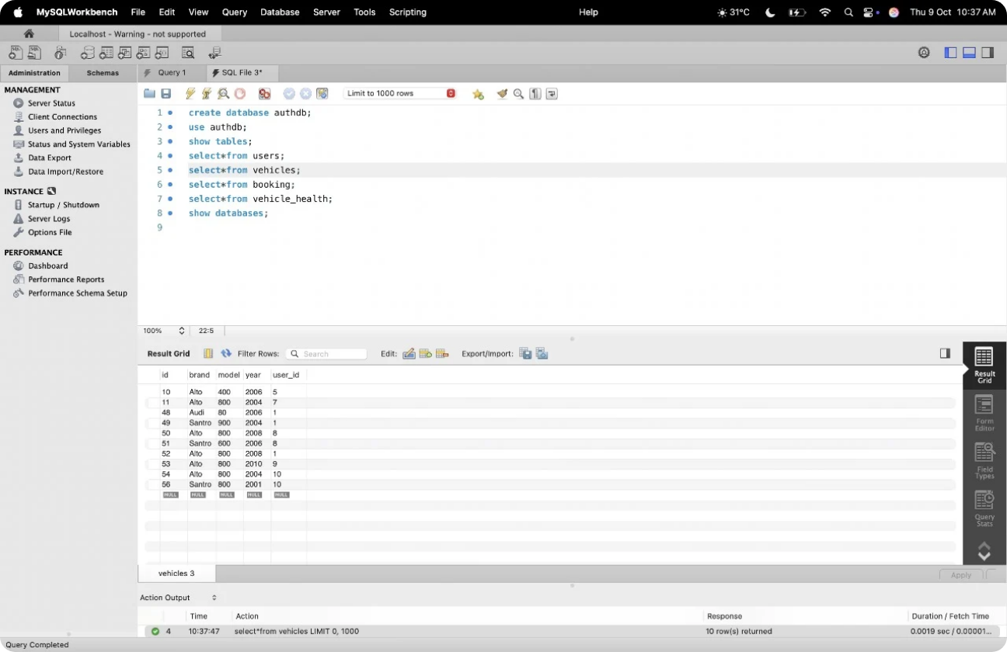
10.Vehicle database
It stores the detials about the Vehicle brand,Model,Year,user_id.

Slide 12
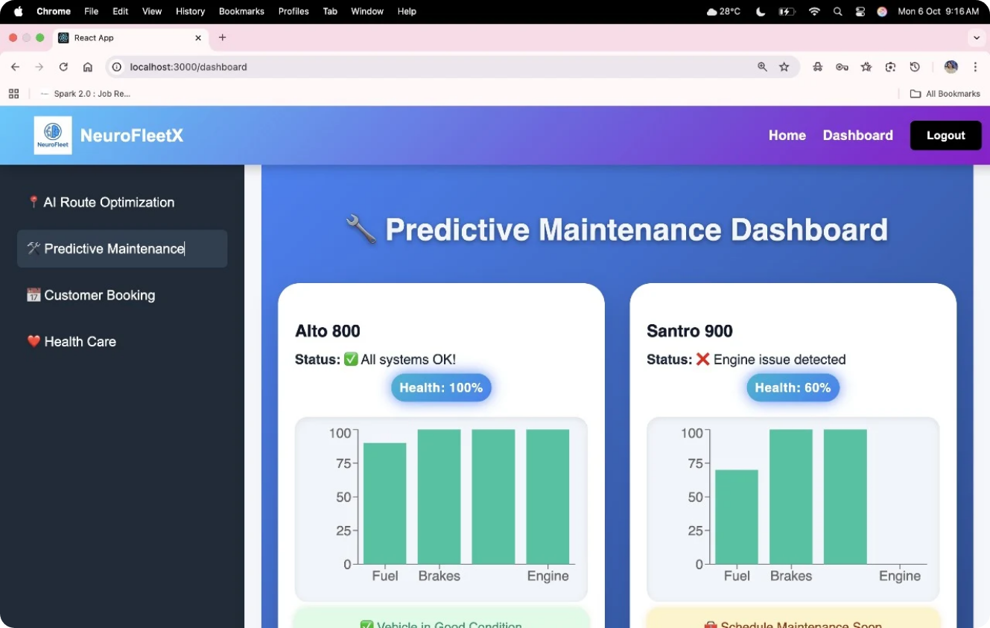
11.Predictive Maintenance
It will show the Status of the System.

Slide 13
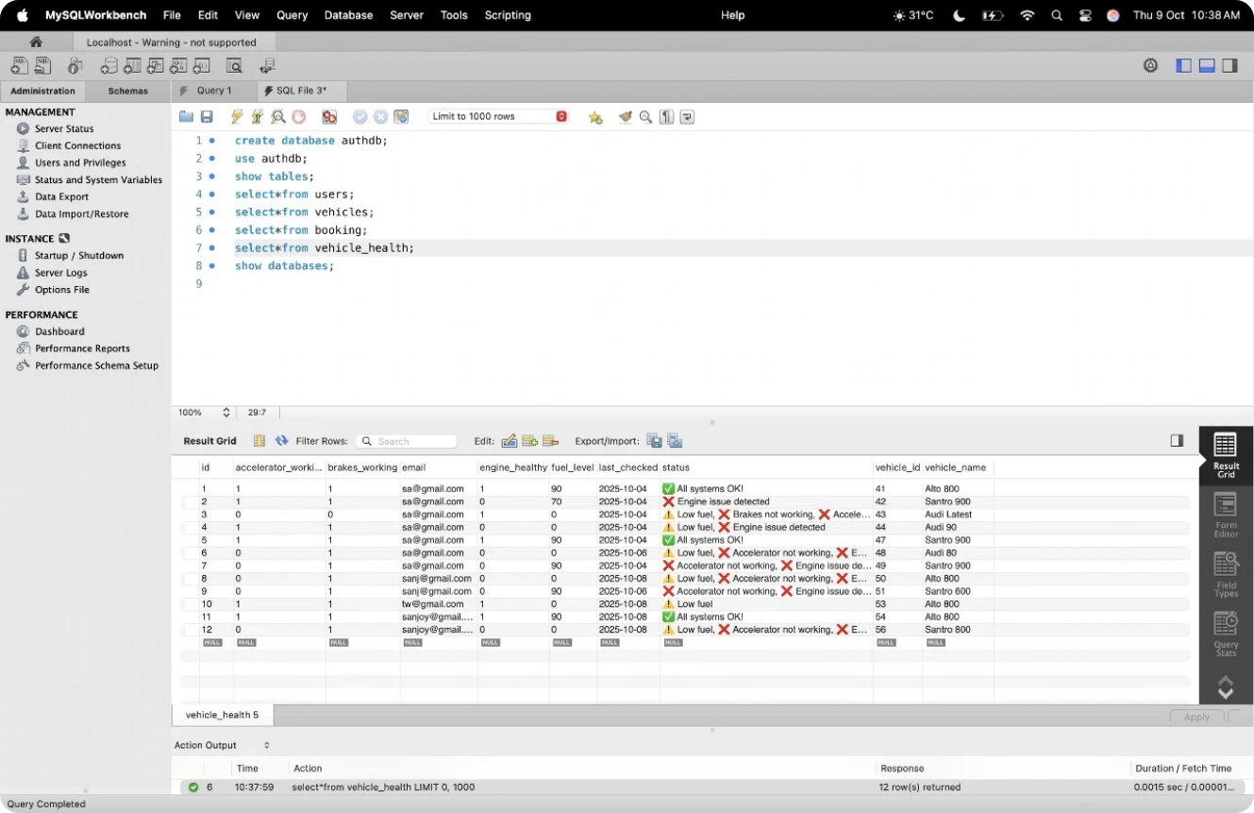
12.Vehicle Health database
It stores the data of the Vehicle health which includes working of accelerators,breake,engine health and Vehicles name and id.

Slide 14
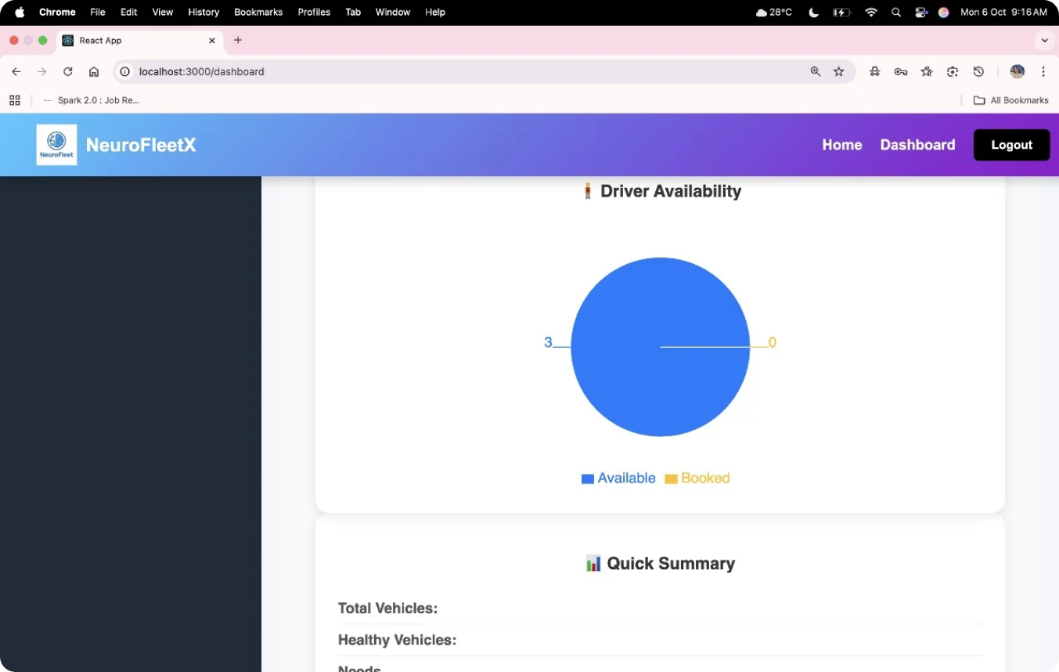
13.Driver Availability
Static driver list linked with your Gmail account.

Slide 15
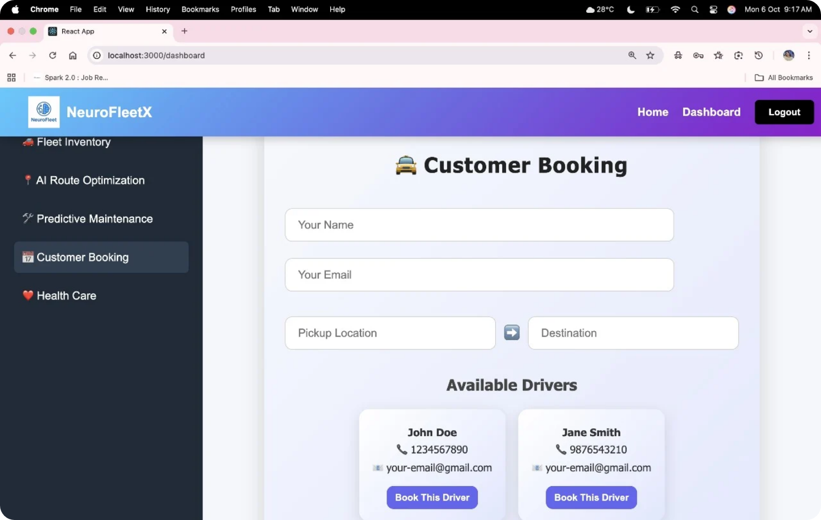
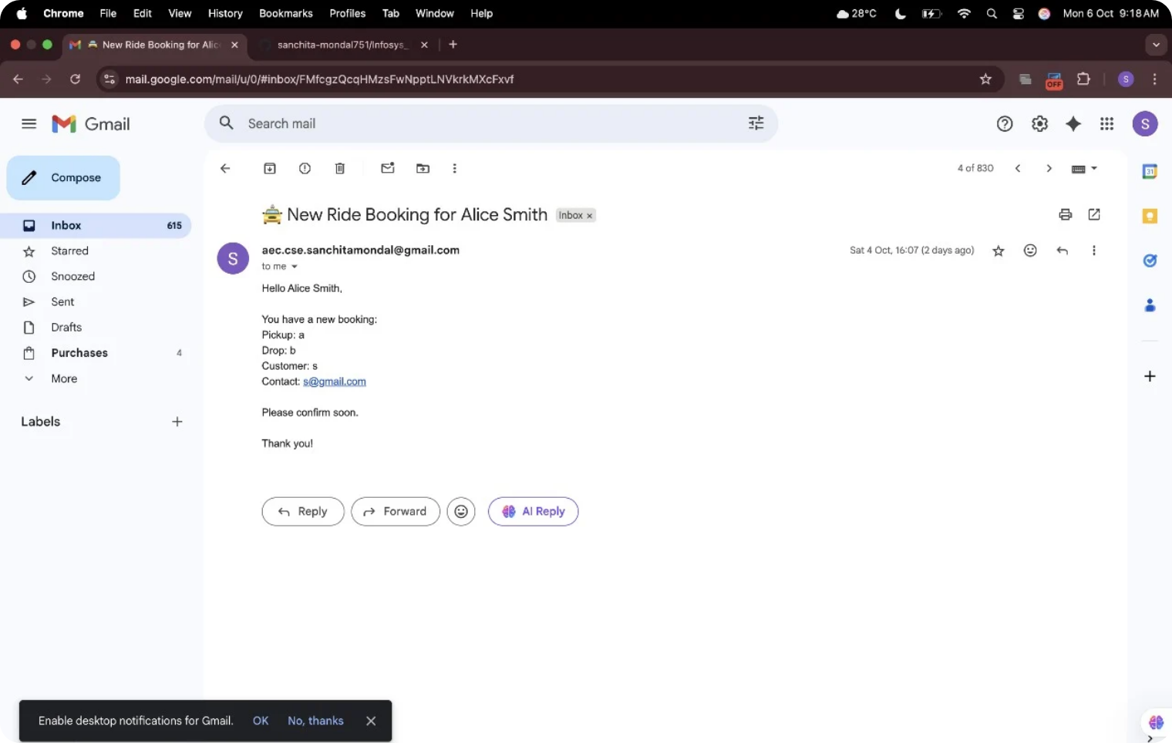
14.Module 3 – Booking System
Manual booking using Gmail-linked user ID.

Slide 16
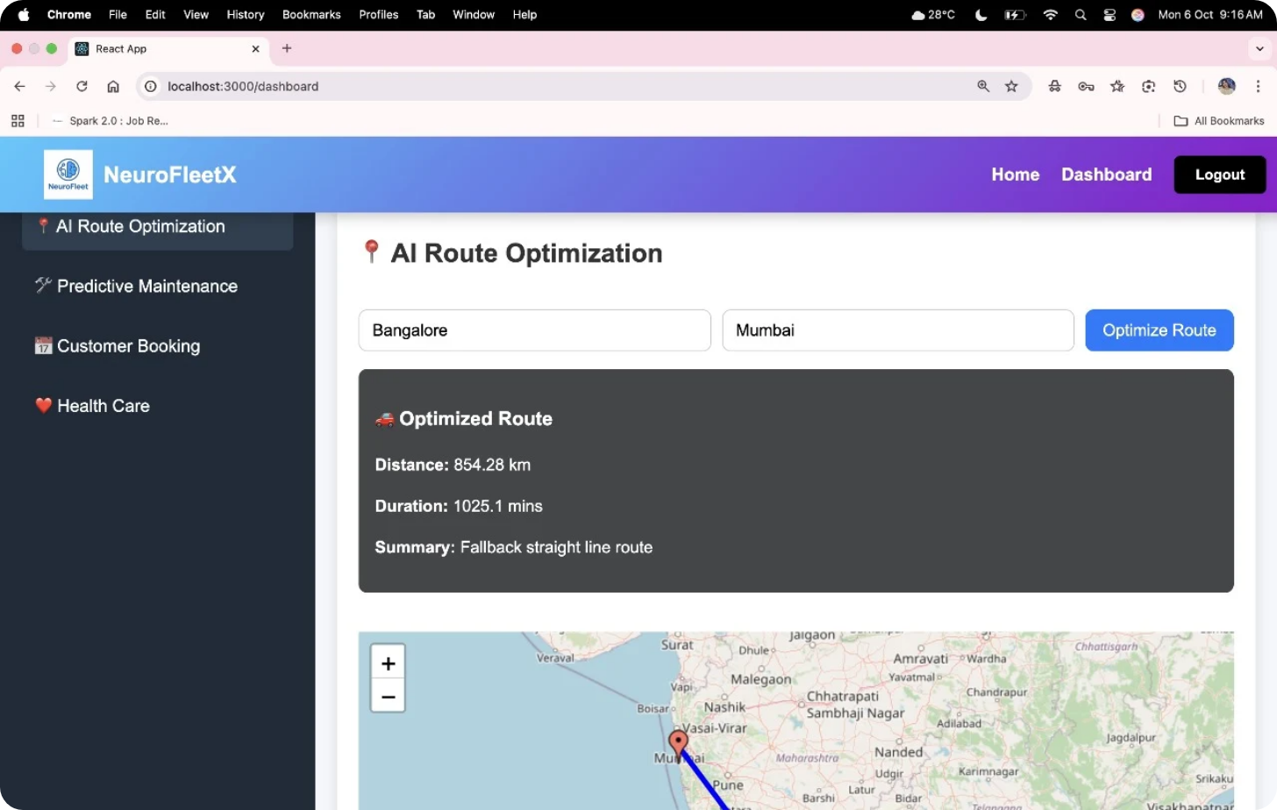
15.AI - Route Optimization
Static path distance displayed between two selected points.

Slide 17
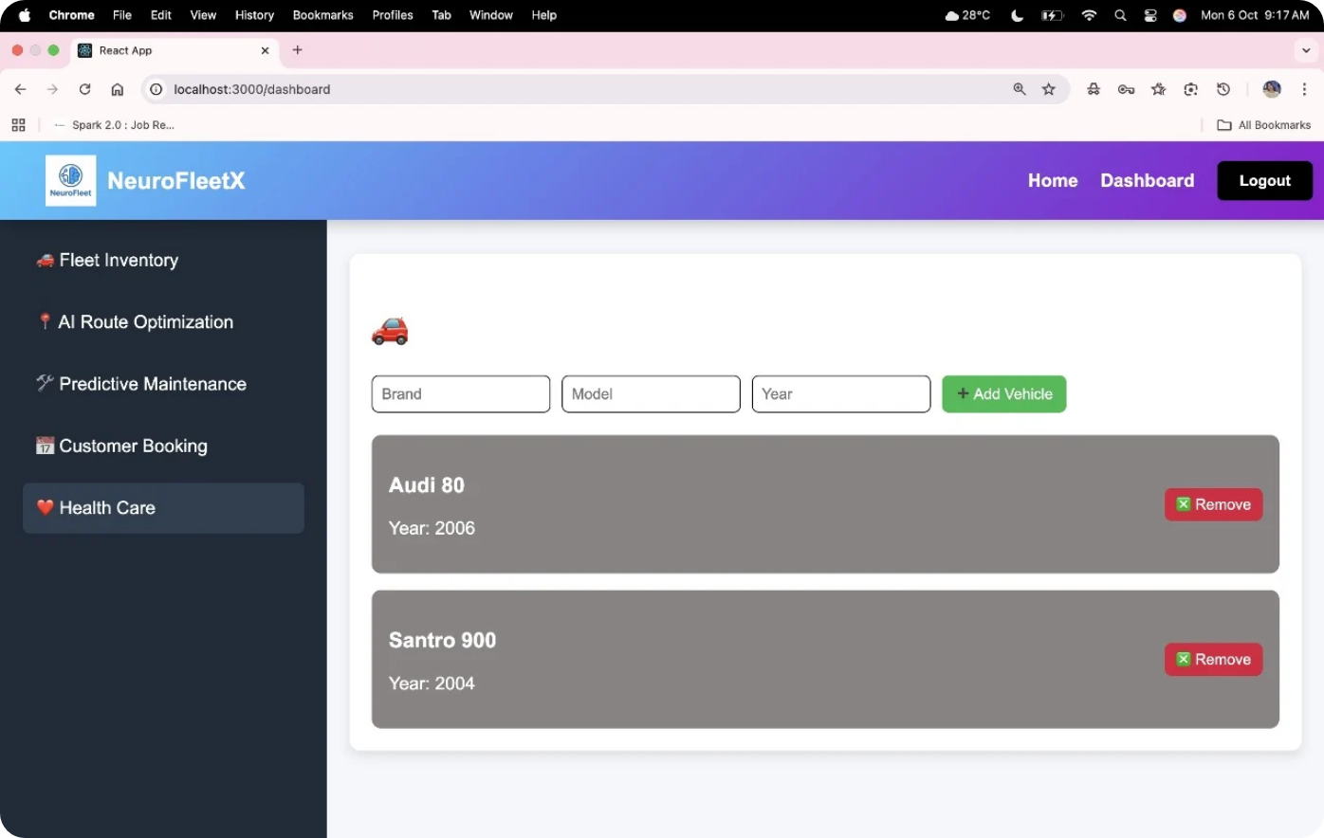
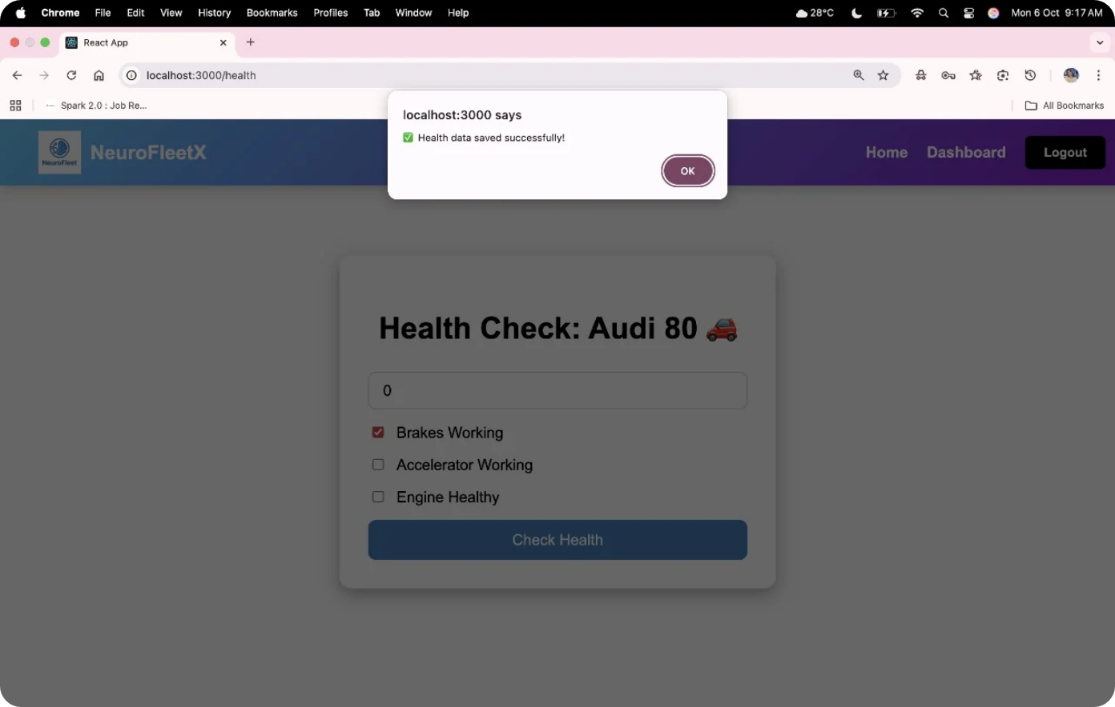
16.Module 4 - Health Care
It will check the health of the particular vehicle.

Slide 18
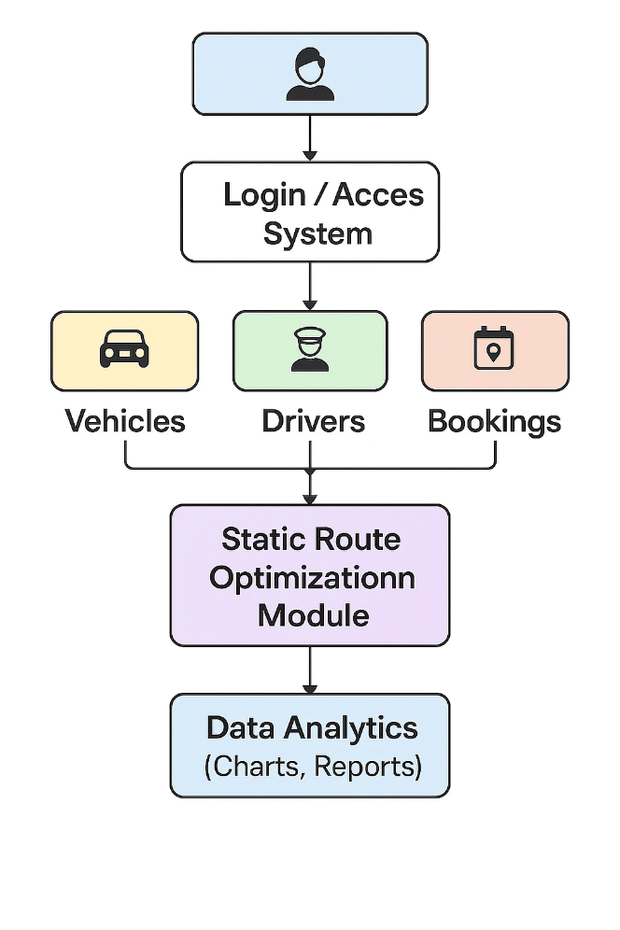
17.UML Diagram / System Flow
1.User/Admin – Access the system.
2.Login/Access System – Authenticates and authorizes users.
3.Vehicles, Drivers, Bookings – Core modules for fleet details, driver info, and trip management.
4.Static Route Optimization Module – Optimizes routes using data from the above modules.
5.Data Analytics – Generates charts and reports for performance insights.

Slide 19
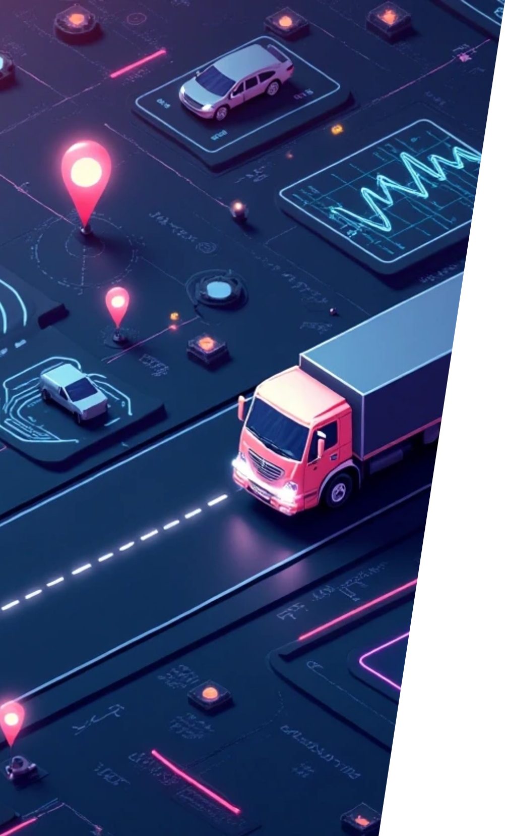





18. Future Enhancements
We plan to enhance the project in the following ways:
1
2
Integration with Spring AI and LLM Models
Dynamic Driver Availability System
To recommend optimized routes dynamically using contextual and historical data.
Allow drivers to log in and mark their availability in real-time.
3
4
Role-Based Authentication
Predictive Maintenance Alerts
Introduce worker, driver, and admin roles with secure access.
Notify the admin when a vehicle’s health drops below threshold.
5
Live Traffic Integration (Google Maps / AI Models)
Replace static distances with real-world dynamic routing.

Slide 20
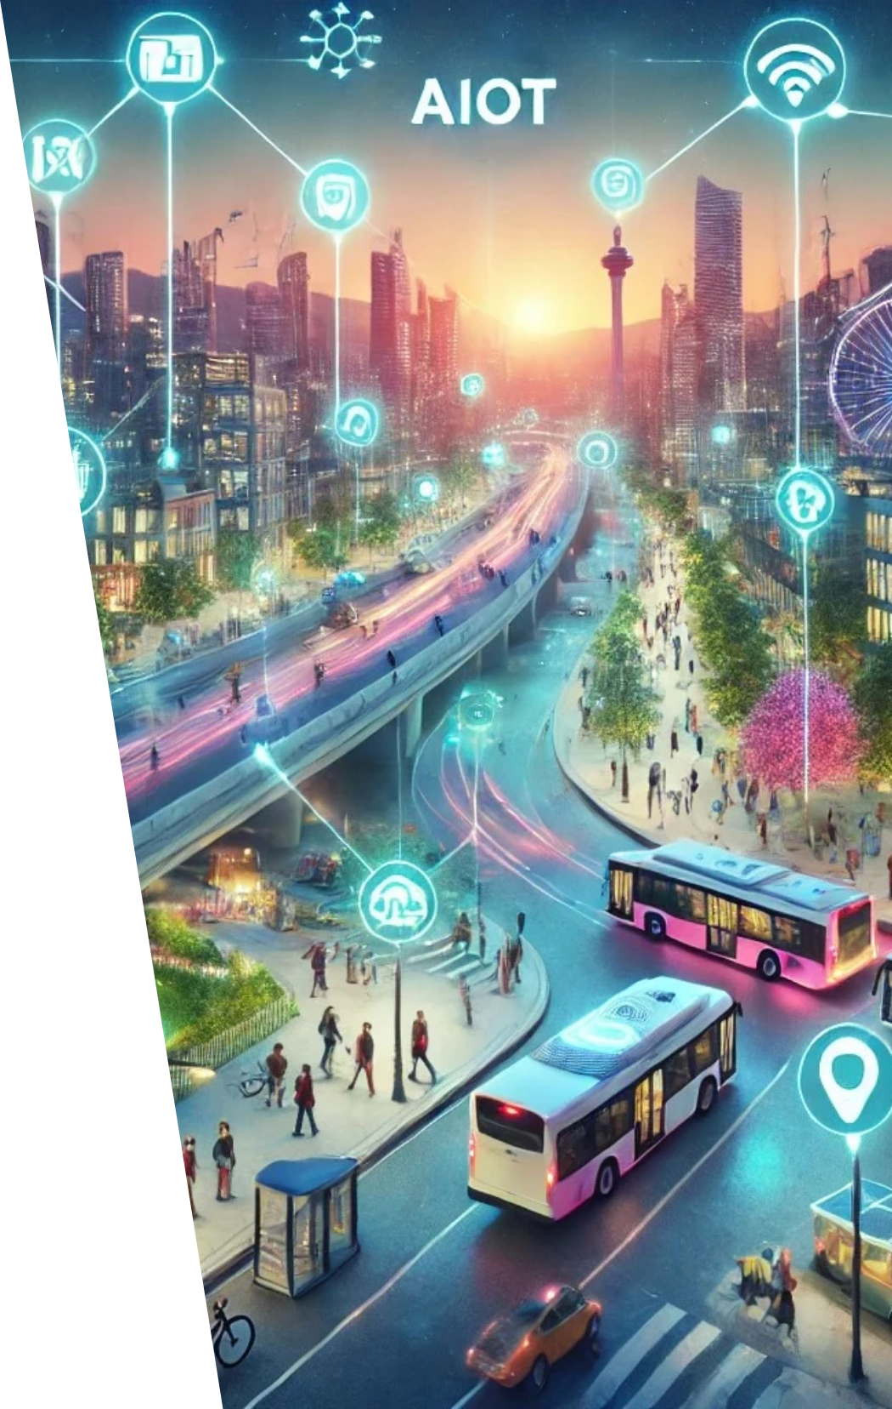

19. Conclusion
The Fleet Management and Route Optimization System successfully demonstrates how a modular full-stack architecture can simplify complex fleet operations.
We achieved:
Centralized management of vehicles and drivers.
Static route optimization and trip tracking.
Visual analytics using charts and reports.
A scalable architecture ready for AI-based extensions.
In essence:
Our project lays the groundwork for an intelligent fleet management platform — from simple static route calculations today, to AI-driven logistics intelligence tomorrow.

Slide 21

Thank You

